Slide 1
UV Guardian
Team B

Slide 2
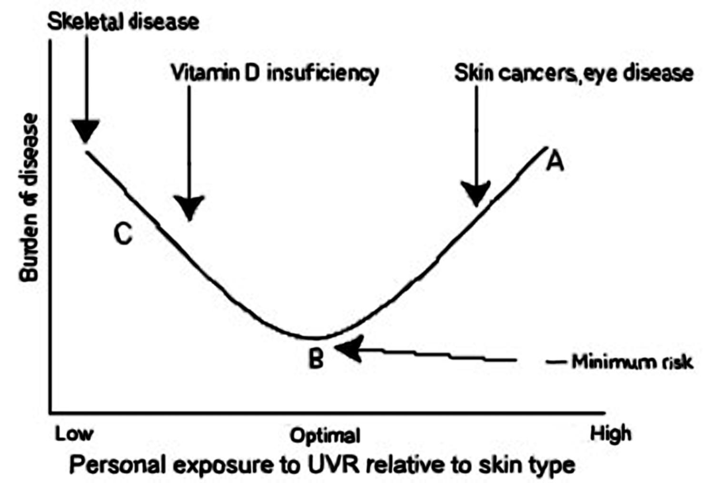
Problem Description
Sunlight is necessary!
Not too little, but not too much
Everyone needs a different amount of UV radiation to stay healthy
Sportspeople are exposed to a lot of UV radiation when outdoors
Skin cancer is the most common form of cancer but is also the most preventable

Slide 3
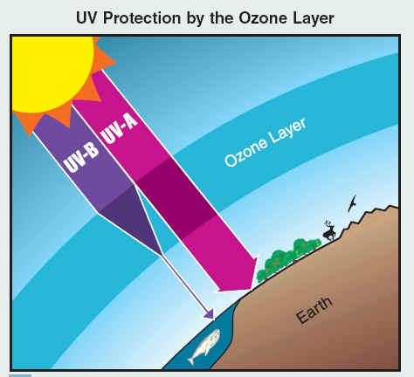
Motivation
For users
Active individuals need a way to track their exposure to UV radiation
Even pedestrians need to prevent overexposure to UV radiation
Help to prevent harmful conditions (such as skin cancer) caused by excessive UV exposure
For research/analytics
Create an easy/cheap method to collect large scale data on UV exposure

Slide 4

Solution
Design an Android app that includes a UV sensor to detect radiation
For the informed user:
Track level of UV radiation throughout the day
Measure the user’s UV index based on their outdoor activities
For the casual user:
Create a social network that allows users to see other’s UV exposure
Allow user to compare UV radiation with Facebook friends’ radiation
Map accumulated UV exposure on a bar graph
Additionally, Researchers would have a database to
reference

Slide 5
Architectural Design
<<system>>
Parse Database
<<system>>
Facebook Servers
<<system>>
UV Guardian App

Slide 6
Use Case
Start and end UV tracker
User
View personal UV exposure data
Compare Facebook friends’
UV exposure levels

Slide 7
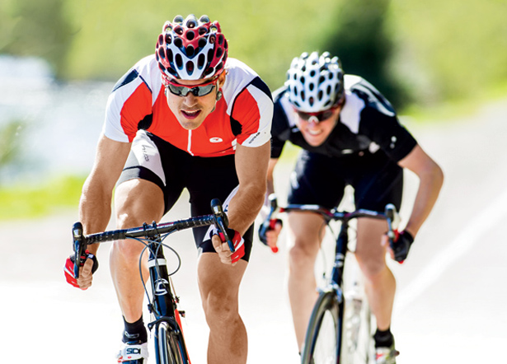
User Characteristics
Sports enthusiasts and other active people who spend large amounts of time outdoors.
Predominantly people who are concerned about their skin condition and overexposure.
Everyday people who are attentive to their health

Slide 8
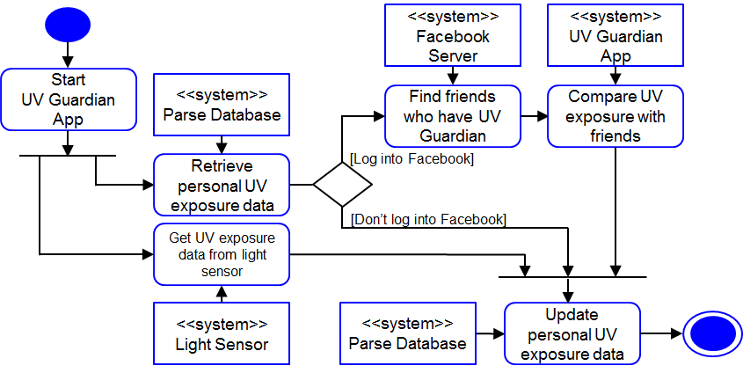
UML Diagrams

Slide 9



Design of Modules
•Facebook Login (Facebook)
•User Details (Parse)
•Add Friends
•Display Graph (Achartengine)
Notes:
Julian - I plan to discuss what each module does in the presentation, so I won’t clutter up the slide with information.

Slide 10
Demo
Facebook login
Relative exposure graph
UV index

Slide 11

Work Completed
Facebook Authentication
Add Friends
Display Graphs

Slide 12
Future Work
•Avatar points on graph
•Different options for graph
•Improve User Interface
•Add friends outside of facebook

Slide 13
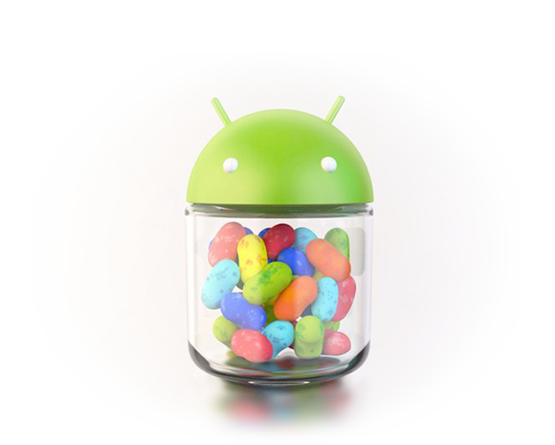
Team Challenges
Android
Communication
Client
Group
Meeting
Time availability
Git

Slide 14
Thank you!
Questions?

